Slide 1


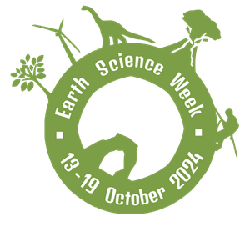

‘Earth Science Everywhere’
13 – 19 October 2024

Slide 2



Earth Science Week is the chance for everyone to discover and learn about the earth sciences.
It shows us how geoscience is connected to our daily lives and the range of careers you can have with geoscience!

Slide 3
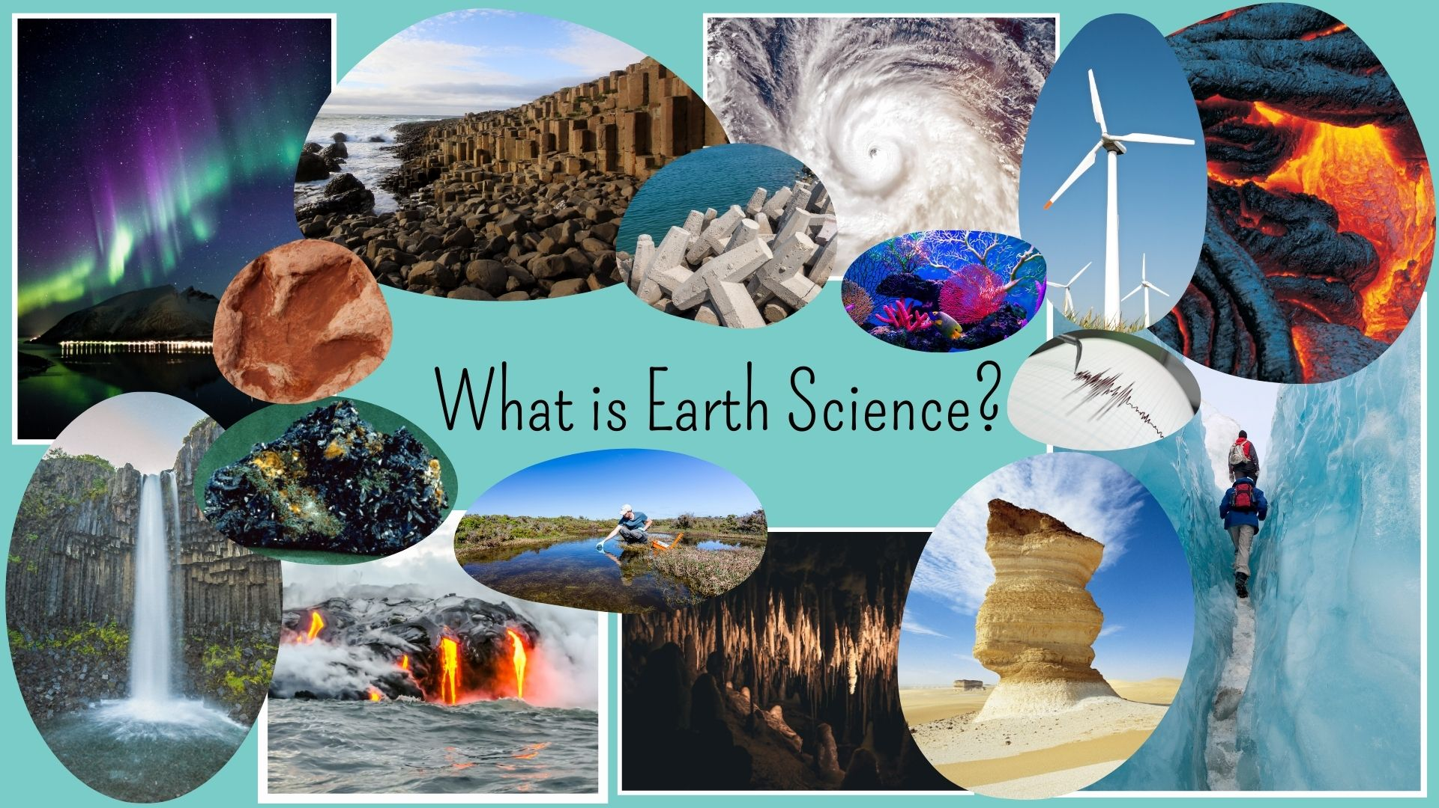
Notes:
Ask the students to look at the different images:
What do they recognise?
Can they name any of the areas of science on display?
Images included (clockwise from top left corner):
Northern Lights (geomagnetism)
Giants Causeway (hexagonal basalt)
Coastal defences
Tropical storm system
Coral reef
Wind turbine
Lava flow
Seismometer (earthquake monitoring)
Glaciers
Rock pedestal (desert)
Stalagmites (cave systems)
River water sampling
Basaltic lava fission
Waterfall
Azurite mineral specimen
Dinosaur footprint (fossil)

Slide 4
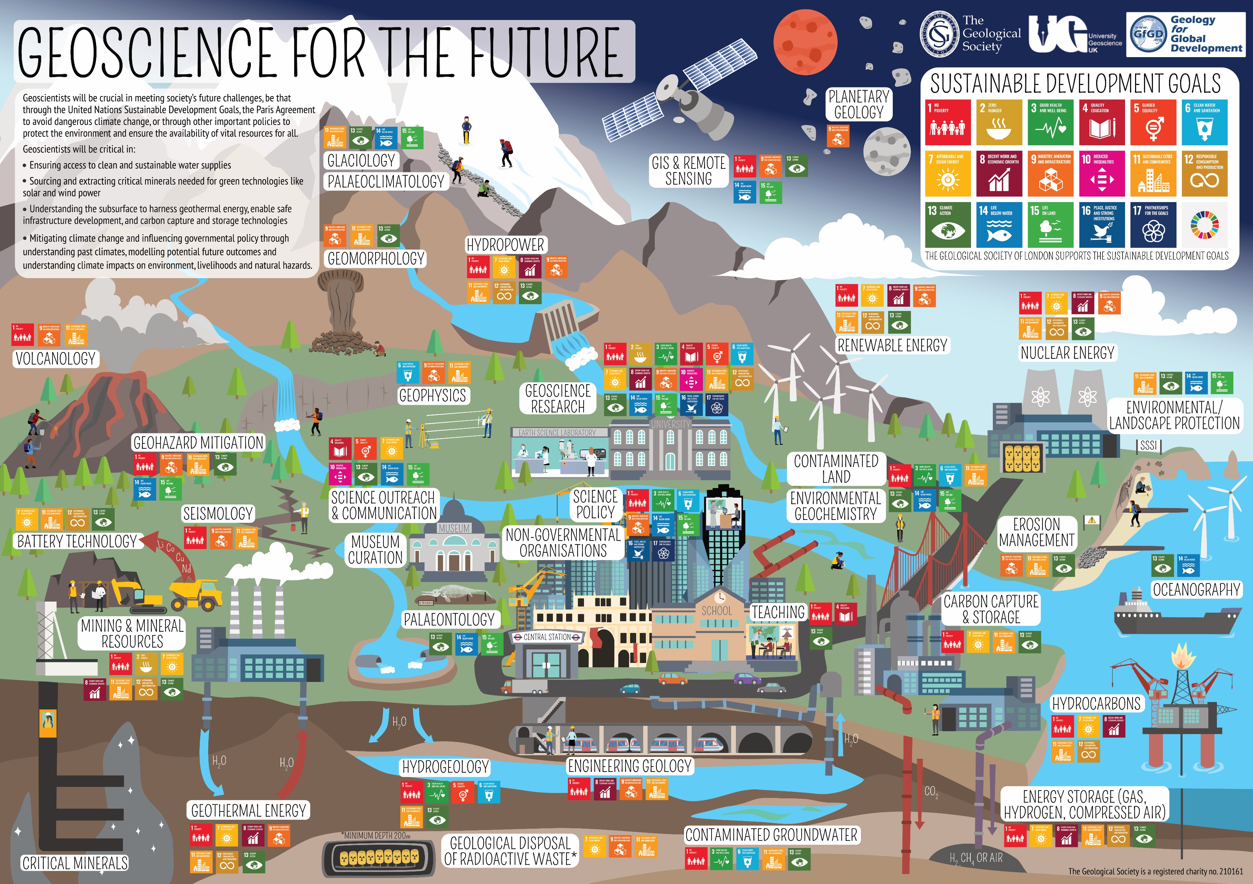

Slide 5

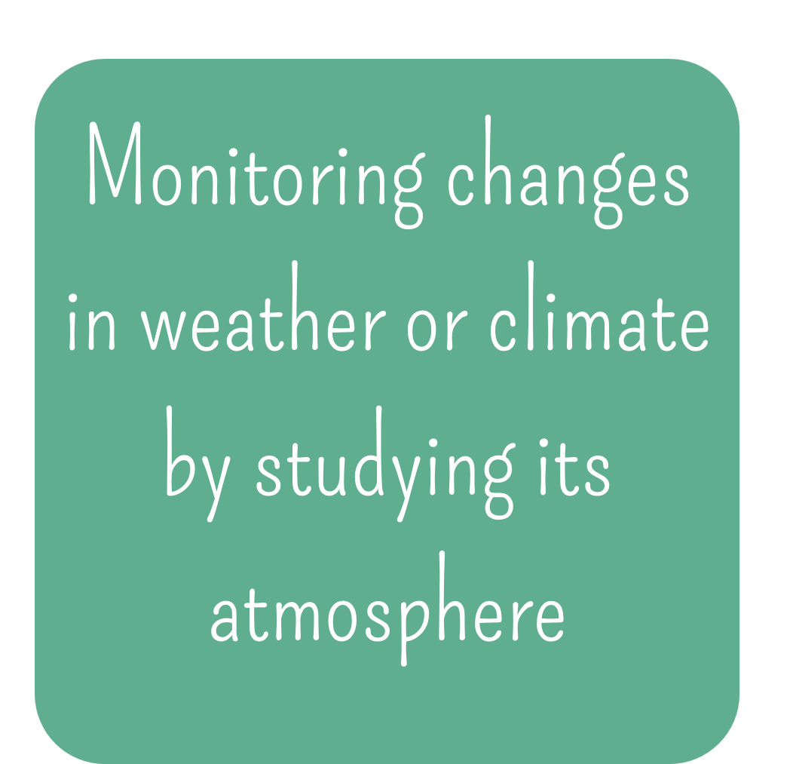
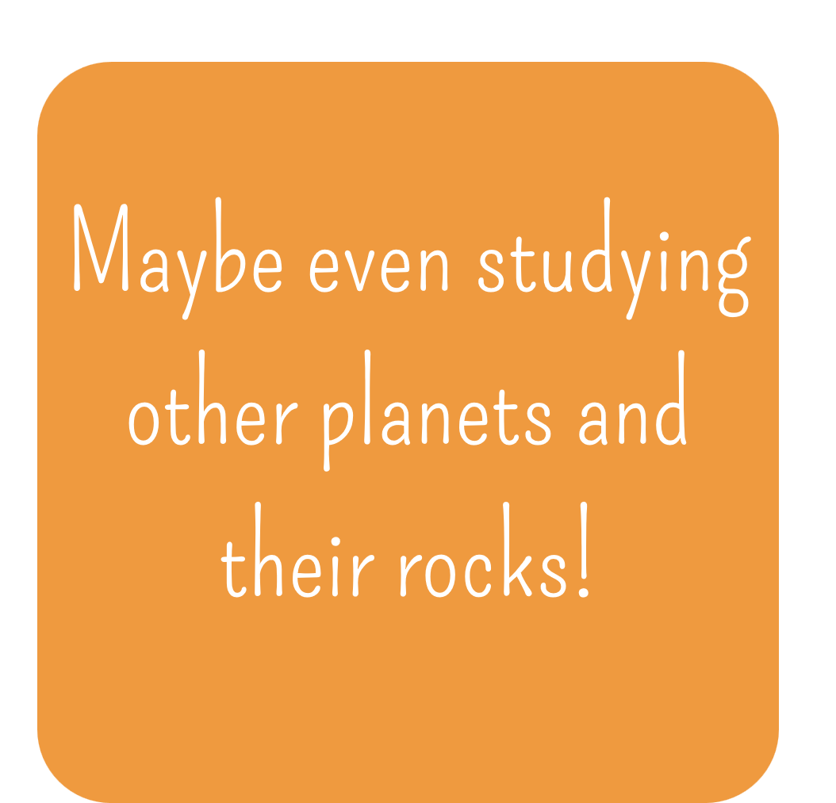
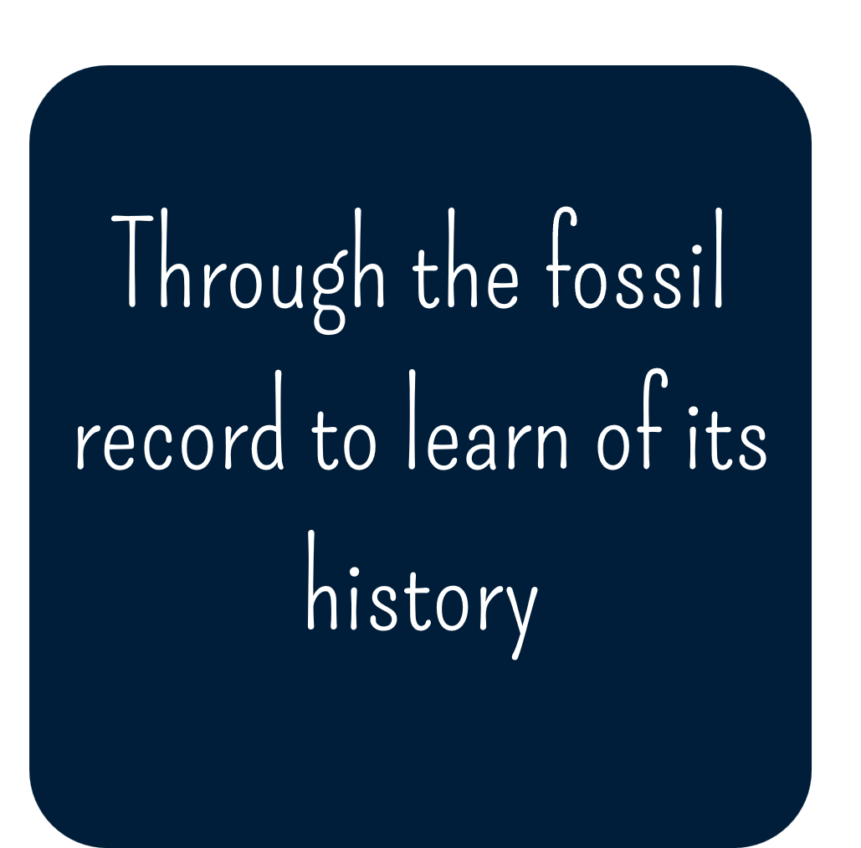
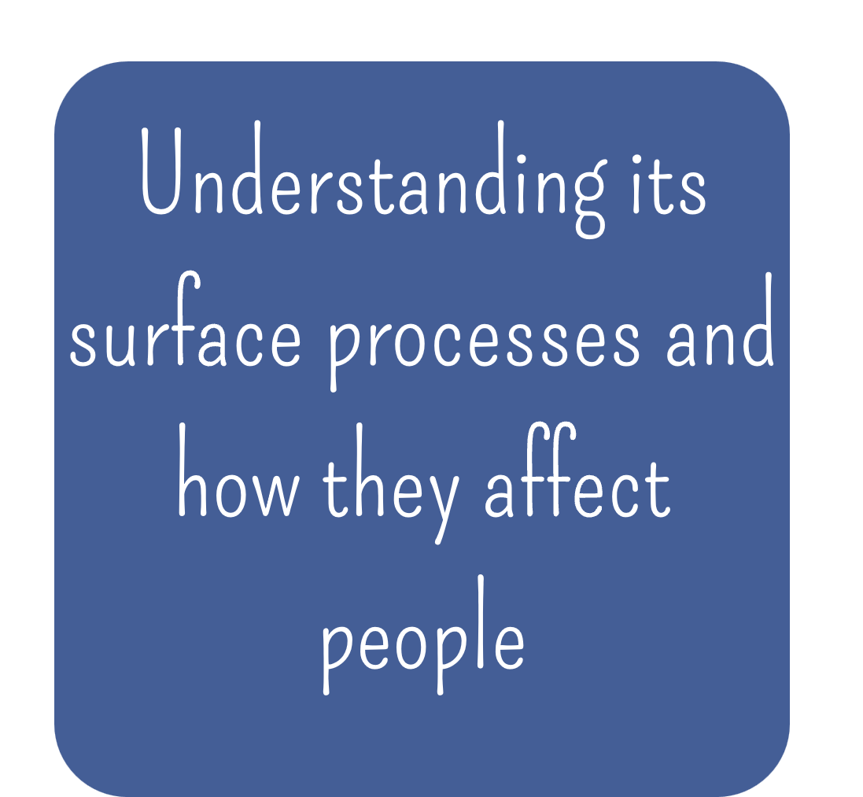
Lots of different things! An earth scientist will be interested in studying the Earth in different ways:

Slide 6

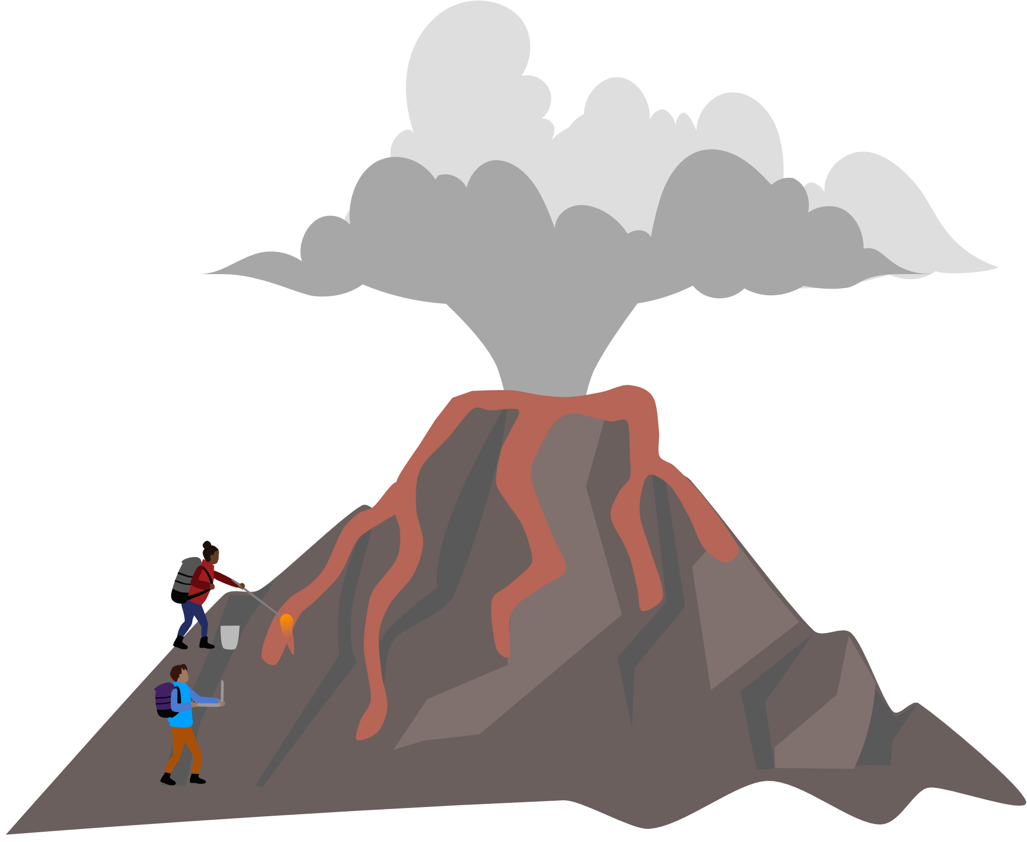
Volcanologists study volcanoes in all stages of activity over the world. They work to monitor their activity to help forecast eruptions and associated geohazards.
You might work in:
Volcano Observatory: monitoring active volcanoes to forecast eruptions
Volcanic Research: studying the formation of different types of volcanoes and patterns of eruption
Geohazard Mitigation: working to stop and limit the
impacts of volcanic hazards to protect communities

Slide 7



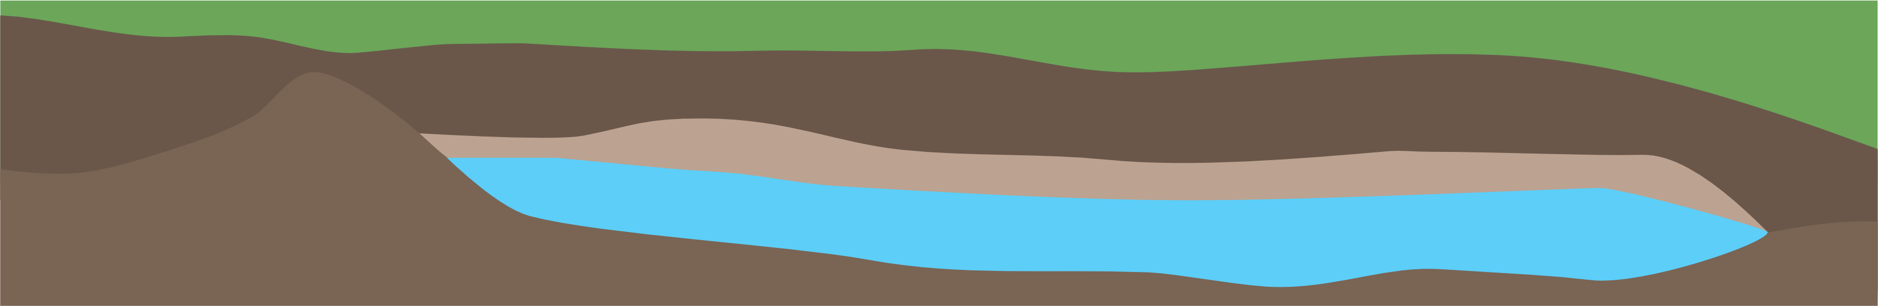
Hydrogeology focusses on groundwater - a hidden but important resource beneath the Earth’s surface. Found in spaces in soil and rock formations, hydrogeologists work to monitor and assess this resource.
You might work in:
Groundwater Sampling: in the field collecting samples to determine the natural quality or pollution of groundwater.
Groundwater Modelling: simulating groundwater flow, recharge, and contamination plumes to help make decisions on how best to manage the resource.
Groundwater Resilience: assess likely future impacts of climate change
and the groundwater’s resilience

Slide 8


Engineering geologists focus their knowledge and skills to help solve engineering problems and issues. This is vital work for urban planning and construction.
You might work in:
Urban Planning: investigate the strength properties of the
ground beneath us to predict how it will respond to being
excavated or built on.
Ground Modelling: develop using geological maps, tested
through logging soil and rock from boreholes.
Geotechnical Solutions: providing advice to a wide range
of clients e.g. government, research organisations, and
consultants.

Slide 9

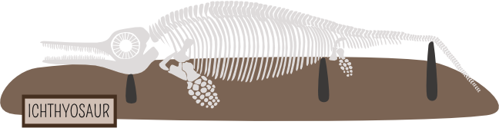
Palaeontologists are scientists who study the history of life on earth through fossils. Fossils are the remains or traces of past life activity on earth for example animal tracks, pollen, and dinosaur skeletons.
You might work in:
Field Work: as a technician excavating fossils, ensuring samples are recorded, analysed and transported safely
Palaeoclimatology: using the fossil record to reconstruct the earth’s past climate and environments
Museum Curation: managing fossil for research and display to the public

Slide 10





Planetary scientists will study celestial bodies such as planets, moons and asteroids to understand their geologic processes. Through this scientists aim to understand what these celestial bodies are made of and how they formed.
You might work in:
Academic Research: investigating climate, tectonics, magnetism and
more on other planets
Government/Space Agencies: working on regulations and
policy in connection with space exploration
Aerospace/Planetary Research: analytical technicians and
engineers operate satellites or even rovers to aid research

Slide 11

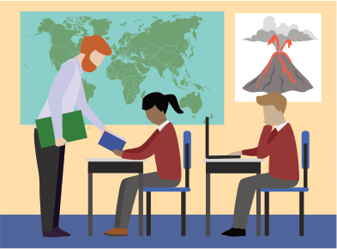
Geology is the subject that involves the most Earth Science but it is not widely taught in schools.
Subjects like science, geography and environmental studies will involve Earth Science and help when moving on to choose your A-levels or Advanced Highers.

Slide 12


Geology is taught as an A-level at some schools and colleges, Geology is not an option as a Highers subject…
…but you do not need to have studied a Geology course to study earth science or geoscience at university!
Here are some of the preferred A-Levels/Highers:
  Physics ⚛
  Maths 📊
  Chemistry ⚗
  Biology 🧬
  Geography 🗺
  Environmental Studies ⛰

Slide 13

Geology Career Pathways:
www.geolsoc.org.uk/careers
Geoscience Careers:
www.americangeosciences.org/education/k5geosource/careers
Geoscientist Job Profile:
www.prospects.ac.uk/job-profiles/geoscientist

